Slide 1
Samsung Innovation Campus
Artificial Intelligence Course
Notes:
Note:

Slide 2
Chapter 10.
Starting an AI Project
AI Course
Notes:
Note:

Slide 3
Samsung Internal Use Only
Update History
Version | Update Details
v1.0 | 1st draft completed
V1.1 | Samsung, SIC logo updated
V1.11 | Chapter info. updated
Notes:
Note:

Slide 4
Chapter 10.
Starting an AI Project
Unit 1. Project Preparation
Notes:
Note:

Slide 5
Chapter 10.
Starting an AI Project
Unit 1. Project Preparation
1.1. Project Planification.
1.2. Searching for Project Ideas.
Unit 2. Design Thinking
2.1. What is Design Thinking and Why?
2.2. Characteristics of Design Thinking.
Notes:
Note:

Slide 6
Unit 1. 1.1. Project Planification
What is data project planification?
Series of preparation tasks before starting a data centric project.
Ingredients of a successful project planification.
“Question first approach”:
A well defined problem should be the priority.
Considerations about data, method, etc. come later.
Focus on the key issues:
Look for key issues first and then expand.
Notes:
Note:
Before we start out with an AI project, we should spend some time planning ahead.
There are well known frameworks for “data projects” which we are about to learn about.
It can never be overemphasized that the problem comes first!
People, often try to find problems suitable to the solution(s) they already have.
Imagine you want to buy yourself a pair of shoes.
Given the size of your feet (problem), you will find shoes of suitable size (solution). Right?
So, the solution comes after a well defined problem. Not the other way round.

Slide 7
Unit 1. 1.1. Project Planification
Project Planification
Four project types:
What to do?
 | Known | UnKnown
Known | Optimization | Insight
UnKnown | Solution | Discovery
How to do?
Notes:
Note:
There are four project types:
1). Optimization: when the problem is known (defined) and the method is also known (decided).
2). Solution: when the problem is known (defined) but the method is still unknown (undecided).
3). Insight: when the problem is unknown (undefined) but the method is already known (decided).
4). Discovery: when the problem is unknown (undefined) and the method is also unknown (undecided).

Slide 8
Unit 1. 1.1. Project Planification
Project Planification
Value vs Time:
Value
Drop in value
Actionable Solution
Time
Delay in time
Notes:
Note:
The value(*) decreases as the actionable solution is delayed.
The goal of a project planification is to cut down the delay so that most of the time value is preserved.
(*) Often you can think of it as “business value”.

Slide 9
Unit 1. 1.1. Project Planification
Project Planification
Value vs Time:
Value
Drop in value
Time
Delay in time
Notes:
Note:
The value(*) decreases as the actionable solution is delayed.
The goal of a project planification is to cut down the delay so that most of the time value is preserved.
(*) Often you can think of it as “business value”.

Slide 10
Unit 1. 1.1. Project Planification
Project Planification
Considerations at the planification phase:
1). How to acquire the data and which method to use.
Volume
Structured
Unstructured
Semi-structured
Notes:
Note:
At the planification phase, we should carefully consider about the data:
+How do we acquire it?
+What is the volume: big, medium, small?
+Is the data structured or unstructured?

Slide 11
Unit 1. 1.1. Project Planification
Project Planification
Considerations at the planification phase:
2). Explore the use cases and preexisting solutions.
3). Identify potential hurdles and plan ahead.
4). Management of updates and actualizations.
Notes:
Note:
Then, we go through other considerations as mentioned here.

Slide 12
Unit 1. 1.1. Project Planification
Project Planification
CRISP-DM (Cross Industry Standard Process for Data Mining):
Data understanding
Data preparation
Business understanding
DATA
Modelling
Iteration
Deployment
Evaluation
Structured approach to planning a data mining project.
Notes:
Note:
CRISP-DM is the most commonly used approach for data mining (*).
The life cycle model consists of six phases with arrows indicating the most important and frequent dependencies between phases. The sequence of the phases is not strict. In fact, most projects move back and forth between phases as necessary. Once we set basic structure of the project with CRISP-DM, we will add design thinking on top of it so that we can easily get to the project idea and develop solutions.
(*) Easily generalizable to AI projects.

Slide 13
Unit 1. 1.1. Project Planification
Project Planification
CRISP-DM (Cross Industry Standard Process for Data Mining):
Data understanding
Data preparation
Business understanding
DATA
Modelling
Iteration
Deployment
Evaluation
Business understanding: analysis of business objectives and needs.
Notes:
Note:
The first step is “business understanding” involving an analysis of business objectives and needs.
Project members should take the time to explore what the project team expects to gain from the project.
Try to involve as many key people as possible in these discussions and document the results. The final step of this CRISP-DM phase discusses how to produce a project plan using the information gathered here.
Although this research may seem dispensable, it's not. Getting to know the business reasons for the data mining effort helps to ensure that everyone is on the same page before expending valuable resources.

Slide 14
Unit 1. 1.1. Project Planification
Project Planification
CRISP-DM (Cross Industry Standard Process for Data Mining):
Data understanding
Data preparation
Business understanding
DATA
Modelling
Iteration
Deployment
Evaluation
Data understanding: exploratory analysis to gain further understanding of the gathered data.
Notes:
Note:
The next step is “data understanding”.
This phase involves taking a closer look at the data available for mining. This step is critical in avoiding unexpected problems during the next phase--data preparation--which is typically the longest part of a project.
Data understanding involves accessing the data and exploring it using tables and graphics. This enables project team to determine the quality of the data and describe the results of these steps in the project documentation.

Slide 15
Unit 1. 1.1. Project Planification
Project Planification
CRISP-DM (Cross Industry Standard Process for Data Mining):
Data understanding
Data preparation
Business understanding
DATA
Modelling
Iteration
Deployment
Evaluation
Data preparation: cleaning, formatting, etc. of the data using the insight gained from the previous steps.
Notes:
Note:
At the “data preparation” step, the data is further prepared and pre-processed.
More specifically this step may involve data transformation, feature engineering, tagging, formatting, normalization, imputation, etc.
Data preparation is one of the most important and often time-consuming aspects of data mining. In fact, it is estimated that data preparation usually takes 50-70% of a project's time and effort. Devoting adequate energy to the earlier business understanding and data understanding phases can minimize this overhead, but the project team still need to expend a good amount of effort preparing and packaging the data for mining.

Slide 16
Unit 1. 1.1. Project Planification
Project Planification
CRISP-DM (Cross Industry Standard Process for Data Mining):
Data understanding
Data preparation
Business understanding
DATA
Modelling
Iteration
Deployment
Evaluation
Modelling: involves selection, optimization and streamlining a predictive model.
Notes:
Note:
At the “modelling” step, a model is selected which goes through the optimization and streamlining process.
This is the point at which your hard work begins to pay off. The data you spent time preparing are brought into the analysis tools, and the results begin to shed some light on the business problem posed during Business Understanding.
Modeling is usually conducted in multiple iterations. Typically, data miners run several models using the default parameters and then fine-tune the parameters or revert to the data preparation phase for manipulations required by their model of choice. It is rare for an team's data mining question to be answered satisfactorily with a single model and a single execution. This is what makes data mining so interesting--there are many ways to look at a given problem.

Slide 17
Unit 1. 1.1. Project Planification
Project Planification
CRISP-DM (Cross Industry Standard Process for Data Mining):
Data understanding
Data preparation
Business understanding
DATA
Modelling
Iteration
Deployment
Evaluation
Evaluation: the model from the previous step is put to test in a realistic scenario.
Notes:
Note:
At the “evaluation” step, the model from the previous strep is put to test in a realistic scenario.
At this point, you've completed most of your project. You've also determined, in the Modeling phase, that the models built are technically correct and effective. Before continuing, however, you should evaluate the results of your efforts. It is here where we decide whether to move on to the “deployment” step or “go back to the drawing board”.

Slide 18
Unit 1. 1.1. Project Planification
Project Planification
CRISP-DM (Cross Industry Standard Process for Data Mining):
Data understanding
Data preparation
Business understanding
DATA
Modelling
Iteration
Deployment
Evaluation
Deployment: the system implemented in a usable format conforming with the business requirements.
Notes:
Note:
At the final “deployment” step, the system is actually implemented in a usable format conforming with the business requirements.
Deployment is the process of using new insights to make improvements.

Slide 19
Chapter 10.
Starting an AI Project
Unit 1. Project Preparation
1.1. Project Planification.
1.2. Searching for Project Ideas.
Unit 2. Design Thinking
2.1. What is Design Thinking and Why?
2.2. Characteristics of Design Thinking.
Notes:
Note:

Slide 20
Unit 1. 1.2. Searching for Project Ideas.
Searching for Project Ideas
Top Down approach vs Bottom Up approach:
When the problem is already well defined ⇒ Top Down approach.
The problem needs to be defined through exploration of data ⇒ Bottom Up approach.
Known
UnKnown
Known
Optimization
lnsight
UnKnown
Solution
Discovery
Top-Down Approach
Bottom-Up Approach
Notes:
Note:
When searching for project ideas:
+Top down approach is applicable when the problem is well defined; we are seeking for “optimization” and/or “solution”.
+Bottom up approach is applicable when the problem is yet to be defined.
We will not state here whether the top down or the bottom up approach is better than the other.
Which approach to take depends entirely on the situation as explained above.

Slide 21
Unit 1. 1.2. Searching for Project Ideas.
Searching for Project Ideas
Top Down approach - Design Thinking:
Five steps: Define, Discover, Analyze, Ideate & Prototype, and Test.
Iterations of convergence and divergence.
Define
Analyze
Test
Discover
Ideate & Prototype
Notes:
Note:
We can get aided with the “design thinking” framework in our search for the project ideas.
In particular, the first three steps “Define”, “Discover”, and “Analyze” are useful.
After define the problem and root-cause, we need to ideate solution and make prototype to solve the problem.

Slide 22
Unit 1. 1.2. Searching for Project Ideas.
Searching for Project Ideas
Top Down approach - Prioritization:
Easy
Highest Priority
III
I
Low Impact
High Impact
IV
II
Lowest Priority
Difficult
Notes:
Note:
Once, you have potential project ideas, try to “score” them in two ways.
1). Impact.
2). Difficulty.
Project idea that is impactful and easy to carry out should receive the highest priority → Quadrant I.
Project idea that is least impactful and difficult to carry out should receive the lowest priority → Quadrant IV. Often this type of project is discouraged.

Slide 23
Unit 1. 1.2. Searching for Project Ideas.
Searching for Project Ideas
Bottom up approach - Data Exploration:
Explore the raw data to find valuable problems and project ideas.
Raw data
Exploration
$ $ $
Value (project ideas)
Notes:
Note:
In the bottom up approach, concrete project ideas should be “unearthed” from the (raw) data through exploration. If we have our own data cumulated for years, we can find project idea and create value by exploring the data. In this capstone project, however, since project topic is not decided and data is not provided, we are not encouraged to explore data end up spending time meaninglessly.

Slide 24
Chapter 10.
Starting an AI Project
Unit 2. Design Thinking
Notes:
Note:

Slide 25
Chapter 10.
Starting an AI Project
Unit 1. Project Preparation
1.1. Project Planification.
1.2. Searching for Project Ideas.
Unit 2. Design Thinking
2.1. What is Design Thinking and Why?
2.2. Five Steps of Design Thinking.
Notes:
Note:

Slide 26

Unit 2. 2.1. What is Design Thinking and Why?
Design Thinking
What is Design Thinking?
It is a way of thinking that helps you to innovate and solve problems like a designer.
“Design thinking is a human-centered approach to innovation that draws from the designer's toolkit to integrate the needs of people, the possibilities of technology, and the requirements for business success.” — Tim Brown, CEO of IDEO
Source: ideo.org (https://www.ideo.org/bio/tim-brown)
Notes:
Note:
Now, let’s talk more about “design thinking”.
Please, remember that design thinking is not just about how it looks like and feels like.
Design thinking is far more encompassing concept.

Slide 27
Unit 2. 2.1. What is Design Thinking and Why?
Design Thinking
What is Design Thinking?
BUSINESS THINKING vs INTUITIVE THINKING
Design
Thinking
100% reliability
50/50 mix
100% validity
Analytical
Thinking
Intuitive
Thinking
Notes:
Note:
Design thinking lies at the intersection between the analytical and intuitive ways of doing things.
It gets the best from the both.

Slide 28
Unit 2. 2.1. What is Design Thinking and Why?
Design Thinking
What is Design Thinking?
KEY ELEMENTS
People-centered
Highly Creative
Start from what people need or want to do
Empathy is key!
You need the ability to understand and share the feelings of others
Design thinking stimulates you to look at situations differently and come up with new solutions, that go beyond and improve existing alternatives
Integrative thinking is key. You need the ability to look at all the different aspects of problem
Stop discussing, start working. Make ideas tangible.
Prototyping is thinking with your hands and Test your hypothesis
Failure is a necessary part of the process. Experiments with trial and error are key.
The road to success does not follow a straight line. The more you are able to loop through “Understand > Create > Learn” cycle, the higher chance you have for good results.
Hands-on
Source: the role of design thinking by Pieter Baert
Iterative
Notes:
Note:
There are four key elements that describes what Design Thinking is.
People-centered: You have to start thinking from a certain point of view. It might be your own or someone else’s. You can interview relevant person if you need. Or you can also draw a persona that represents a certain group of people.
Highly Creative: You need to brainstorm to get as many ideas as you can. In design thinking, you need to pursue quantity over quality. Once you diverge, you can converge afterwards.
Hands-on: Fail fast. You should conduct experiment fast, get feedbacks, and apply them as fast as you can.
Iterative: The art of design thinking lies in the number of prototyping – testing iteration within a given period. If you test and learn many times more than your competitors, you will get more fruitful rewards.

Slide 29
Unit 2. 2.1. What is Design Thinking and Why?
Design Thinking
What is Design Thinking?
HOW DESIGN FEELS
Uncertainty/Patterns/Insights
Clarity/Focus
Research
Concept Prototype
Design
Source: Designing Better (http://designingbetter.ca/)]
Notes:
Note:
In Design Thinking, things get messy quickly. This can make most people uncomfortable. We don’t know where we’re going, but we have the confidence to know we’re going to land somewhere good. Thus, trust in the process and try to focus what really matters.

Slide 30

Unit 2. 2.1. What is Design Thinking and Why?
Design Thinking
What is Design Thinking?
EMOTIONAL INNOVATION
BRANDS
MARKETING
RELATION-SHIPS
BUSINESS
(viability)
EXPERIENCE
INNOVATION
DESIGN
THINGKING
PEOPLE
(desirability)
PROCESS
INNOVATION
TECHNOLOGY
(feasibility)
FUCTIONAL
INNOVATION
Source: IDEO
Notes:
Note:
Thinking like a designer can transform the way organizations develop products, services, processes, and strategy. This approach, which IDEO calls design thinking, brings together what is desirable from a human point of view with what is technologically feasible and economically viable. It also allows people who aren't trained as designers to use creative tools to address a vast range of challenges.

Slide 31
Unit 2. 2.1. What is Design Thinking and Why?
Design Thinking
Design Thinking vs Analytical Thinking comparison:
 | Design Thinking | Analytical Thinking
Foundation | Story | Data
Outcome | Insight | Information
Direction | Innovation | Improvement
Starting point | Empathy | Hypothesis
Methodology | Iteration | Optimization
Procedure | Action first | Plan first
Key value | Human | Physical world
Notes:
Note:
Here, we compare the key aspects of “design thinking” vs “analytical thinking”.

Slide 32
Unit 2. 2.1. What is Design Thinking and Why?
Design Thinking
Concept of Design Thinking
Innovative methodology that interprets a problem in a human-centered way through empathic observations of people and things, clearly defines the problem, then visualizes ideas, rapidly prototypes and performs tests repeatedly
Design Thinking is a clear and reliable way of solving problems that anyone can use to achieve concrete, practical results.
(Case of application)
- Solve problems with dense and crowded living spaces and minimize stress.
- Use resources around us efficiently and minimize energy consumption.
Notes:
Note:

Slide 33
Unit 2. 2.1. What is Design Thinking and Why?
Design Thinking
Reason for Design Thinking
To solve problems related to the people of society
Design thinking is necessary to solve people's problems (the difficulties we face in our daily lives).
e.g. crowded train stations, online banking with poor Internet transmission, and traffic congestion are occurring in our daily lives, and we are facing frustration and social problems.
By applying the principle of design thinking, rational and best possible alternatives can solve these problems better, faster, and smoothly.
Types of problems that can be resolved by Design Thinking
Issues not clearly defined
Problems Insufficient Information to Create a Solution
Problems that Strongly Affect People's Needs
Problems with changing circumstances
Notes:
Note:

Slide 34

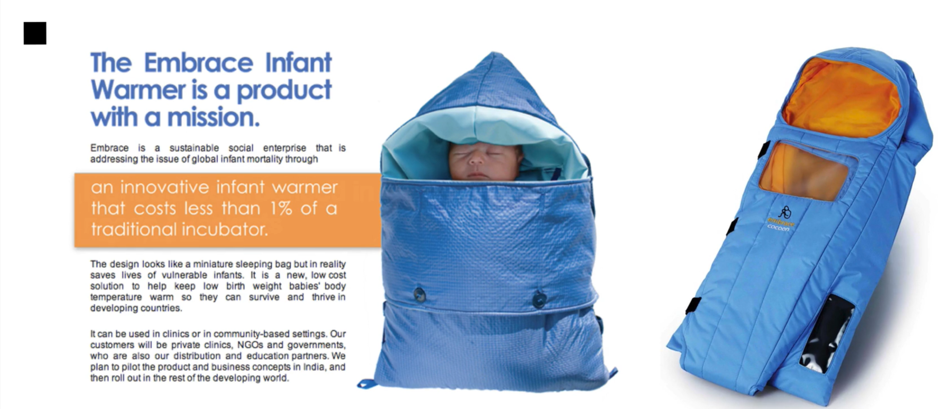
Unit 2. 2.1. What is Design Thinking and Why?
Design Thinking
Case Study - Embrace Infant Warmer
Start with a design school project of four Stanford University students
4 millions of babies die within first month after birth
Accurate Understanding of Incubators: Optimal Products, Not Low-cost Products
Newborn warmers priced at 1% of existing incubators
Notes:
Note:

Slide 35
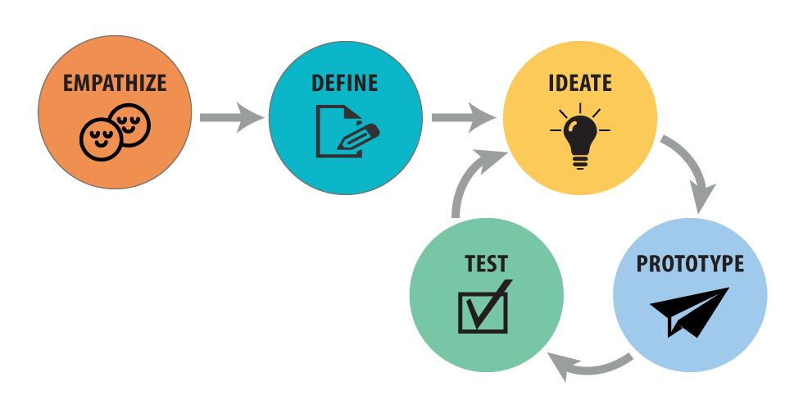





Unit 2. 2.1. What is Design Thinking and Why?
Design Thinking
Four Characteristics of Design Thinking
1) Planning the design is not "brainstorming," nor is it a "one-day work process."
The design execution plan is not an instant process. It takes time and effort of dedicated and committed members to participate to achieve a common purpose.
2) Work repeatedly in design thinking.
Planning the design is an iterative process, and each step needs to be repeated in the forward and backward directions. This iteration makes a variety of discoveries and ultimately arrives at the desired result acquisition or decision point.
DEFINE
DISCOVER
ANALYZE
TEST
IDEATE & PROTOTYPE
Notes:
Note:

Slide 36
Unit 2. 2.1. What is Design Thinking and Why?
Design Thinking
Four Characteristics of Design Thinking
3) In the design action plan, all participants should be able to collaborate and work together. In a true Design Thinking process, every participant (investigators, business leaders, designers, engineers, etc.) must be involved in everything from start to finish. All team members should work together to gain deep insights (a deep understanding of what the real problem is and what users or customers are asking for).
4) Each step of planning the design has an output. As each step of Design Thinking is carried out, various outputs that can be used as evaluation criteria are produced. Each deliverable is not required and not all deliverables. Optionally create the required deliverables, given the nature of the projects involved.
Notes:
Note:

Slide 37
Unit 2. 2.1. What is Design Thinking and Why?
Design Thinking
Required list of materials for Design Thinking
Suitable collaboration space
Paper
Writing instruments
Tools for Cutting or Pasting
Camera / Images
Sketchbook
Post-it
Cardboard
Whiteboard / Wall / Pinboard
Card
Prototyping Materials
Framework
Notes:
Note:

Slide 38
Chapter 10.
Starting an AI Project
Unit 1. Project Preparation
1.1. Project Planification.
1.2. Searching for Project Ideas.
Unit 2. Design Thinking
2.1. What is Design Thinking and Why?
2.2. Five Steps of Design Thinking.
Notes:
Note:

Slide 39
Unit 2. 2.2. Five Steps of Design Thinking
Design Thinking
Convergence and Divergence:
Define
Analyze
Test
Discover
Ideate & Prototype
Discover and Define
Develop and Deliver
Notes:
Note:
Design thinking is structured in five steps with convergence and divergence cycles.

Slide 40
Unit 2. 2.2. Five Steps of Design Thinking
Define
Step #1: Define
Define
Analyze
Test
Discover
Ideate & Prototype
Use the insight obtained from observing and talking.
Identify problems that are highly valuable, inspiring and real.
Answers to “who”, “what”, “why”, etc.
Notes:
Note:
In the first step, we gain empathy from the user through observation and taking (interview).
The outcome from this step is to gain empathy. We should feel the user’s pain and difficulty as our own.
The key points are:
+Observe, engage and listen.
+Empathy = Em (in) + Pathos (feeling), meaning immersion into some else’s experience and feeling.
Next, we identify problems that are valuable, inspiring and real.
The key points are:
+Use the insight gained from the previous step.
+Ask questions such as:
“who needs help?”
“where lies the value?”
“what is the direction we are to follow?”
“why was the problem/pain caused in the first place?”

Slide 41
Unit 2. 2.2. Five Steps of Design Thinking
Define
Guide to writing problem definition proposals:
1. What problem do you want to solve? Please input in the following sentence.
What is a method of [Where] [Who] [What problem] [-Do not ~] [-Do ~]
e.g. 1. [Children's House] [Nursery teachers] [In a situation where parents' distrust prevails] [without misunderstanding] [What is the way to communicate with their parents?] → Preparing tools for communication between nursery teachers and parents
e.g. 2. [Over the world] [Disabled] [In a situation where you can't communicate with others] [without expensive money] [What is the method for social networking?] → Communication device design for the disabled by using proper technology
e.g. 3. [Every day at school] [Students] [when they eat] [without compulsory means] [How can they reduce the amount of food waste?] → Design for the solution for the remnants of school meals
Notes:
Note:

Slide 42
Unit 2. 2.2. Five Steps of Design Thinking
Define
Guide to writing problem definition proposals:
2. How did you come across this problem? And why do you want to solve it?
3. What do you think is the cause of this problem?
4. How will this work out for the world? Explain how the effects can be measured.
If this problem is solved, 1) Social effects: through (example) 2) Personal effects: through (example)
Notes:
Note:

Slide 43
Unit 2. 2.2. Five Steps of Design Thinking
Define
Guide to writing problem definition proposals (Example):
1. What problem do you want to solve? Please input in the following sentence. What is a method of [Where] [Who] [What problem] [-Do not ~] [-Do ~]
What is the way to [diagnose ocular disease] [of people with low income] [in developing countries] [to provide timely treatment to prevent avoidable blindness and visual impairment]?
2. How did you come across this problem? And why do you want to solve it?
Of 285 million people who are visually impaired, 90% are living in developing country. Over 90% of visual impairment result from chronic causes and over 80% of visual impairment could have been prevented by a proper intervention on each life stage.
Underprivileged people are more prone to contract a disease than other people. Visual impairment is one of the main causes of poverty, and once those who are visually impaired are recovered, they can return to economically active population and recover productivity.
Notes:
Note:

Slide 44
Unit 2. 2.2. Five Steps of Design Thinking
Define
Guide to writing problem definition proposals (Example):
3. What do you think is the cause of this problem?
Most of ophthalmoscopes are not affordable to be implemented locally in developing countries. Thus, early detection of ocular diseases whose timely diagnosis is critical to treatment is extremely unachievable.
4. How will this work out for the world? Explain how the effects can be measured.
If this problem is solved, Social effects: social costs will be reduced through the prevention of blindness in the developing countries. Personal effects: through early detection of ocular disease, individuals will less suffer from poverty that comes from decrease in productivity due to the visual impairment.
Notes:
Note:

Slide 45
Unit 2. 2.2. Five Steps of Design Thinking
Discover
Step #2: Discover
Define
Analyze
Test
Discover
Ideate & Prototype
In this stage, Data research, observation research, and interview are primarily done
Observe, talk and feel!
Notes:
Note:

Slide 46
Unit 2. 2.2. Five Steps of Design Thinking
Discover
Process
In the situational discover stage, the first step is to investigate the existing information related to the problem and the solution of others through the 'data survey', and construct the hypothesis through your own critical thinking.
Data Research
Academic data / Magazine articles / Statistics
Observation Research
People / Environments / Tools / Activities
Interview
Recipient Interview / Specialist Interview
>
>
Notes:
Note:

Slide 47
Unit 2. 2.2. Five Steps of Design Thinking
Discover
Data(Document) Research:
Good research is essential to the process of delivering effective solutions.
When you find a problem you want to solve, you need to know what research has already been done in the relevant field to come up with an influential solution that will help you solve the problem. Rather than answering and approaching problem solving, it's important to look for clues that can help you find unexpected solutions through the situation observation phase.
If you're new to the topic, you'll need relevant books, articles, research, papers, and web documents to help you get background and problem information, explore a vast amount of resources, and find effective ways to solve your challenges.
Notes:
Note:

Slide 48
Unit 2. 2.2. Five Steps of Design Thinking
Discover
Data(Document) Research:
01. Is it reliable?
When looking for a material, check whether the author of the material is an expert in the field, if it was created too long ago, and whether the information is from a trusted source or individual. For example, blog posts from non-professionals, intellectual answers from search portals, etc., are information with low credibility.
02. Isn't it duplicated?
Look for items that have been presented in the past with research, best practices, and problem-solving solutions, and make sure that other solutions aren't already solved or ideas that overlap with recent technology advances. Creating a simple timeline can help. Summarize important content in relevant resources and use the team's critical thinking to think about the significance and application of the material.
Notes:
Note:

Slide 49
Unit 2. 2.2. Five Steps of Design Thinking
Discover
Observation and Investigation:
Based on the information obtained through the research, we select a place related to the problem and visit.
You can find the right place to experience the situation in question directly or indirectly, and then observe the subject in the field and see unconscious and natural behavior that is not expressed in language. The richer the findings and questions from observational investigations, the easier it is to determine where the challenges are to be addressed in the next step, the orientation phase.
01. Think freely
02. Looking at a New Perspective
03. Record in Detail
There is no one right answer.
Put yourself in the shoes of the person experiencing the problem and look at the problem from a new perspective.
Write freely what they see, what they see, what they question.
Even minor findings can lead to very meaningful solutions, so think without limiting them.
Observe the things that have been taken for granted.
You may see things you've never seen before, and discover new problems.
For example, are bookstores where people go to buy books?
Writing down findings, questions, etc. in detail develops ideas and leads to more ideas.
Your records will serve as an important foundation for finding true solutions in the next step, Direction Finder.
Notes:
Note:

Slide 50




Unit 2. 2.2. Five Steps of Design Thinking
Discover
Observation and Investigation:
Visiting the site with team members, the team members observe each 15 minutes with four perspectives (people, tools, environment, and activities) of the survey guide.
Organize the observations, findings, and questions related to each view in the appropriate guide plate.
PEOPLE Observing people TOOLS Observing tools
ENVIRONMENT Observing environment
ACTIVITY Observing activity
Notes:
Note:

Slide 51

Unit 2. 2.2. Five Steps of Design Thinking
Discover
Observation and investigation (Example):
PEOPLE Observing people TOOLS Observing tools
People who are not afford to go to regional medical clinic visit public health center
Receive eye check ups without fundus camera
ENVIRONMENT Observing environment
ACTIVITY Observing activity
Ocular diseases need to be diagnosed early and be given proper treatments
Most people in developing countries miss this chance when they visit public health center
Most people are prescribed simple analgesic without being diagnosed disease and dissatisfied with the treatment
Notes:
Note:

Slide 52
Unit 2. 2.2. Five Steps of Design Thinking
Analyze
Step #3: Analyze
Define
Analyze
Test
Discover
Ideate & Prototype
Interiorize the problem as one’s own.
Learn more about persona and understand situation and circumstances more deeply
Notes:
Note:

Slide 53
Unit 2. 2.2. Five Steps of Design Thinking
Analyze
Persona:
Definition
Persona is a hypothetical person who represents the type of people who can use a product or service and is based on data obtained from various surveys.
Through the process of setting up the Persona we think is who the solution is, thinking about the beneficiary's position, and building consensus, the Persona created in the Analize process continues to be a tool to identify what a recipient really needs. If we can truly understand and empathize with the persona we've created, the solution that we're going to create will be a necessary, sustainable solution for the world.
What to consider when creating Personas
Based on the research we found ourselves to predict most closely how someone will behave in a particular situation and environment. You don't need to use the actual survey, but like introducing my best friend, draw a Persona with a distinct personality.
You don't have to worry that Persona will look biased. Personas don't have to be generalized. They characteristically paint Personas even though they're a bit extreme.
Notes:
Note:

Slide 54
Unit 2. 2.2. Five Steps of Design Thinking
Analyze
Persona:
1. Demographic
By setting objective elements that describe a persona, such as age, gender, and occupation, it is easy for anyone to think about who the person is. By subdividing the persona with this basic information, it becomes clear which group of people the persona represents.
I am _____ years old.
My job is ________________, and what I do is ___________________.
Notes:
Note:

Slide 55
Unit 2. 2.2. Five Steps of Design Thinking
Analyze
Persona:
2. Touchpoint
What kind of person do we set up to meet people, what things to carry, and in what environment?
By looking at Persona's life through social groups, essential items, and key environments, we can map out specifically what the recipient wants in an environment and what factors should be considered in order for the solution to be meaningful to be used for future development.
Social Group: What kind of people does Persona live with, talk to, and share her thoughts? I think about the people around Persona, and I think about who is and why it is now.
Essential Items: What items does Persona carry around all the time or are important items? While looking at the essential items, we also think about why such items are essential for Persona.
Major Environments: Where do Personas usually spend their time? Think about it all, including physical environments such as schools, stores, banks, and bus stops, as well as digital environments such as websites, SNS pages and mobile apps.
Notes:
Note:

Slide 56
Unit 2. 2.2. Five Steps of Design Thinking
Analyze
Persona:
3. Value
Based on the findings from various surveys, it defines the 'value' that the beneficiary thinks meaningfully. What does this person think as the most important thing? What makes this person happy? Is there anything you try to keep?
Based on the following questions, try to find the core value our Persona has.
In order to solve the problem in the right direction, it is very important to find the core value that Persona thinks is meaningful.
What amuses me is _______________________________________ .
What I think is important to me is ____________________________________ .
What I hate very much is ______________________________________ .
My goal is ______________________________________________ .
Notes:
Note:

Slide 57
Unit 2. 2.2. Five Steps of Design Thinking
Analyze
Persona:
4. Behavior
Describes actions that reflect the core values of Persona..
Even in the same problematic situation, people's behavior can vary depending on what they value.
Consider and list the behaviors that directly or indirectly relate to the problems we have defined that best represent Persona's thoughts.
Notes:
Note:

Slide 58
Unit 2. 2.2. Five Steps of Design Thinking
Analyze
Persona:
5. Wants
Describe what the beneficiary wants based on his or her core values and behavior.
By thinking specifically about what the beneficiary wants and expressing it in one sentence, we set the direction of the solution that we will develop in the future.
What are some of the inconveniences Persona feels, and in what direction do you want them to be resolved in the future?
What is the first thing that needs to be addressed? What can be better now?
Look at the wants described with Persona's mind and think about their priorities.
Notes:
Note:

Slide 59
Unit 2. 2.2. Five Steps of Design Thinking
Analyze
Persona (Example):
I am 55 years old.
I am a daily wage construction worker, and what I do is building houses located in the suburban area.
What amuses me is a meal voucher provided by municipality.
What I think is important to me is save money as much as I can since I might have no work to do if I get older.
What I hate very much is the fact that blurriness in the eye disturbs me a lot recently.
My goal is to achieve economic stability without worrying about subsistence
Notes:
Note:

Slide 60

Unit 2. 2.2. Five Steps of Design Thinking
Analyze
Persona (Example):
55 / Male
Age / Gender
Value
Behavior
Economic stability
Seek for economic stability
Daily wage construction worker
Sweets lover
Eat sweets but have diabetes
Occupation
Alcoholic
Drink a bottle of liquor everyday
Underserved community
Subsistence
Always buy products with lowest price
Social Group
living in suburban area
Social Circumstances
Visiting medical clinic to check-up for ocular disease
Getting medical advice with low or no medical cost
Eating sweets without worrying about diabetes
Wants 1
Wants 2
Wants 3
Glucose meter
Essential Items
Notes:
Note:

Slide 61

Appendix. Persona
Age / Gender
Value
Behavior
Occupation
Social Group
Social Circumstances
Wants 1
Wants 2
Wants 3
Essential Items
Notes:
Note: You can imagine who would be beneficiary of your products or services. Then, choose one person in mind, create image of the person, and write down who the person is. Describe details as much as possible.

Slide 62
Appendix. Empathy Map
MOTIVATING
“I love…”
“I hate…”
DEMOTIVATING
Notes:
Note:
Imagine a persona and what the person wants and hates as well. Then, you will more deeply understand how the person feels.

Slide 63
Unit 2. 2.2. Five Steps of Design Thinking
Ideate
Step #4: Ideate
Define
Analyze
Test
Discover
Ideate & Prototype
Ideate is a step that envisions and actually makes a solution to solve the social problems selected above.
Based on what you have written during the analysis phase, consider what solution you need.
Notes:
Note:
The key points are:
+Explore, generate and visualize (literally meaning to draw it!).
+Brainstorm and gather ideas.
+Add on to someone else’s ideas without being critical.
+The facilitator may throw in “trigger questions”.

Slide 64
Unit 2. 2.2. Five Steps of Design Thinking
Ideate
Brainstorming:
Definition and Necessity of Brainstorming
Brainstorming is a method that puts as many ideas as possible as if storm is striking in the head. As you share ideas with many people, not thinking about it alone, you can use various perspectives and make a better solution by combining ideas.
Notes:
Note:

Slide 65
Unit 2. 2.2. Five Steps of Design Thinking
Ideate
Brainstorming:
Things to consider during Brainstorming
Put as many ideas as possible. Idea can give a birth to another idea. Brainstorm again with the new born idea and come up with more ideas.
When putting ideas, use ‘Post It’. You can share easily when you write single idea down on one ‘Post It’. The process of grouping and prioritizing can be more convenient, too. Also, if necessary, you can draw a picture to replace a detailed explanation.
Proceed after you decide the time. Without another limit, write ideas down continuously until the decided time.
If flow of thoughts gets slowed down, check the idea list. Some of the ideas can be better and give birth to another idea.
You don’t have to deduce the conclusion while you are brainstorming. Do not be hasty in idea stage. Think whether there is a way to make it a better idea.
Notes:
Note:

Slide 66
Unit 2. 2.2. Five Steps of Design Thinking
Ideate
Idea Grouping:
Through Idea Matrix, make a group from the ideas deduced by brainstorming and prioritize them. Divide into two criteria; creativity(horizontal) and plausibility(vertical). Then you will know what idea to solutionize for the first thing.
Discuss together about whether it has been tried, whether there is to benchmark, whether it is already executed. To determine plausibility, think together about what is a required technology or infra, and whether there is a better solution in terms of effect and cost. When you choose an idea, it is effective to do it with the specialists. Proceed with the specialist matched to your team.
Notes:
Note:

Slide 67
Appendix. 2 by 2 matrix
Unknown Idea
Known Idea
A
B
Actionable
C
D
Not actionable
Notes:
Note:

Slide 68
Appendix. Sticky Notes
Cluster and Piles
Links
Grids
Axes
Circles and Targets
Metaphors
Notes:
Note:
Ideate with sticky notes. You can use many different ways of grouping ideas other than 2 by 2 matrix.

Slide 69
Unit 2. 2.2. Five Steps of Design Thinking
Ideate
Experience Mapping
Definition
Experience Mapping is a method of developing ideal beneficiary experience. When you apply the solution to the problem, it plans all elements required to provide the most ideal experience . Through mapping, you get to know to whom, when, how, what benefit the solution provides.
Things to consider Experience Mapping
Keep in mind that the subject of Experience Mapping is the Persona. Think about experience from beneficiary’s perspective.
All solutions are not like a magical thing that happens instantaneously. They are composed of experiences and chain of moments. Through Experience Mapping, check once again whether you designed the solution after capturing the right moment, place, and person for the solution.
Notes:
Note:

Slide 70
Unit 2. 2.2. Five Steps of Design Thinking
Ideate
Experience Mapping
Experience Mapping How-to
1) Decide the whole context of the problematic situation and think about in what order what touchpoints are linked.
2) Put the actions that are expected at each touchpoints.
3) To create a rapport and to elevate understanding, visualize the touchpoints and the happening things, and explain them in single story.
4) After looking at the big picture, figure out how the current problem can turn out if the chosen idea becomes a real solution.
Is this really the necessary solution for the beneficiary?
Is the part to which the solution is applied the most suitable touchpoint for the solution?
For the solution to work, what must be done before and after the solution?
5) Find the way that can complement the solution.
Notes:
Note:

Slide 71
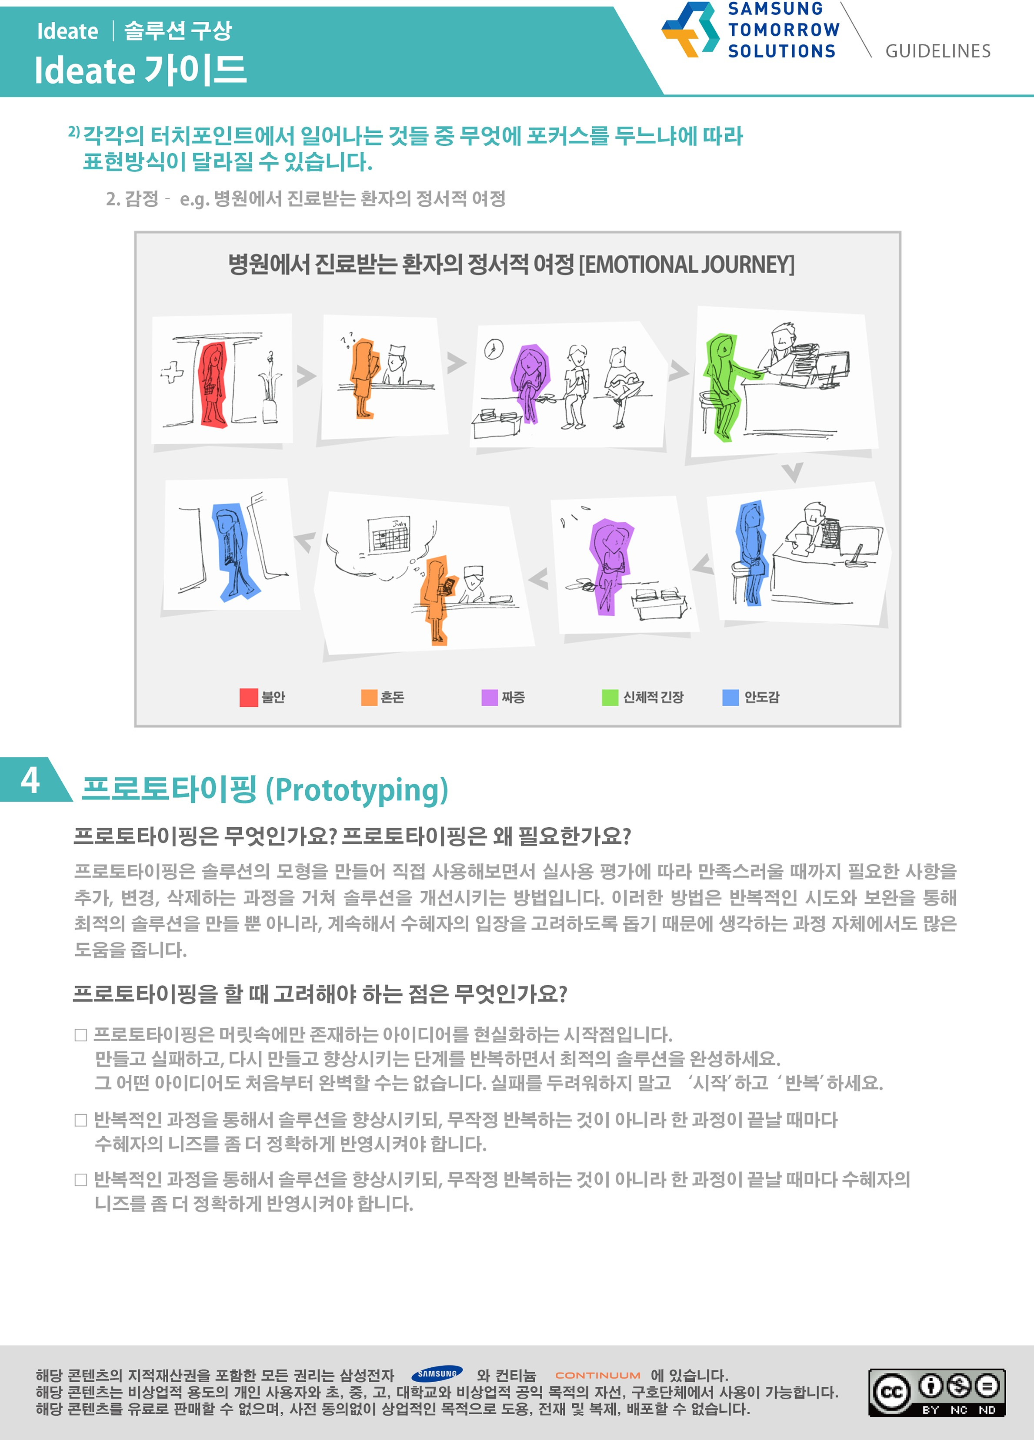
Unit 2. 2.2. Five Steps of Design Thinking
Ideate
Experience Mapping
“Way to express can differ according to on which touchpoints to put the focus on.”
Emotional Journey
Emotional Journey of Patients Treated in Hospital
Anxiety
Chaos
Irritation
Physical strain
Relief
Notes:
Note:

Slide 72
Unit 2. 2.2. Five Steps of Design Thinking
Ideate
Prototyping
Definition and necessity of Prototyping
A way to improve the solution through the process of adding, changing, deleting things to the point of satisfaction according to the real-using evaluation.
This not only make the optimal solution through repetitive trying and complementation, but also helps to consider the beneficiary’s perspective, so it helps a lot in thinking, too.
Things to consider for prototyping
Prototyping is a starting point that materializes ideas that exist only in mind. Make and fail, re-make it and improve it, and then complete the best solution. Not any idea can be perfect from the start. Do not be afraid of failure. ‘Start’ and ‘Repeat’.
Improve the solution through repetition. It does not mean the pure repetition. You have to reflect more precisely the needs of the beneficiary at every intervals.
Notes:
Note:

Slide 73
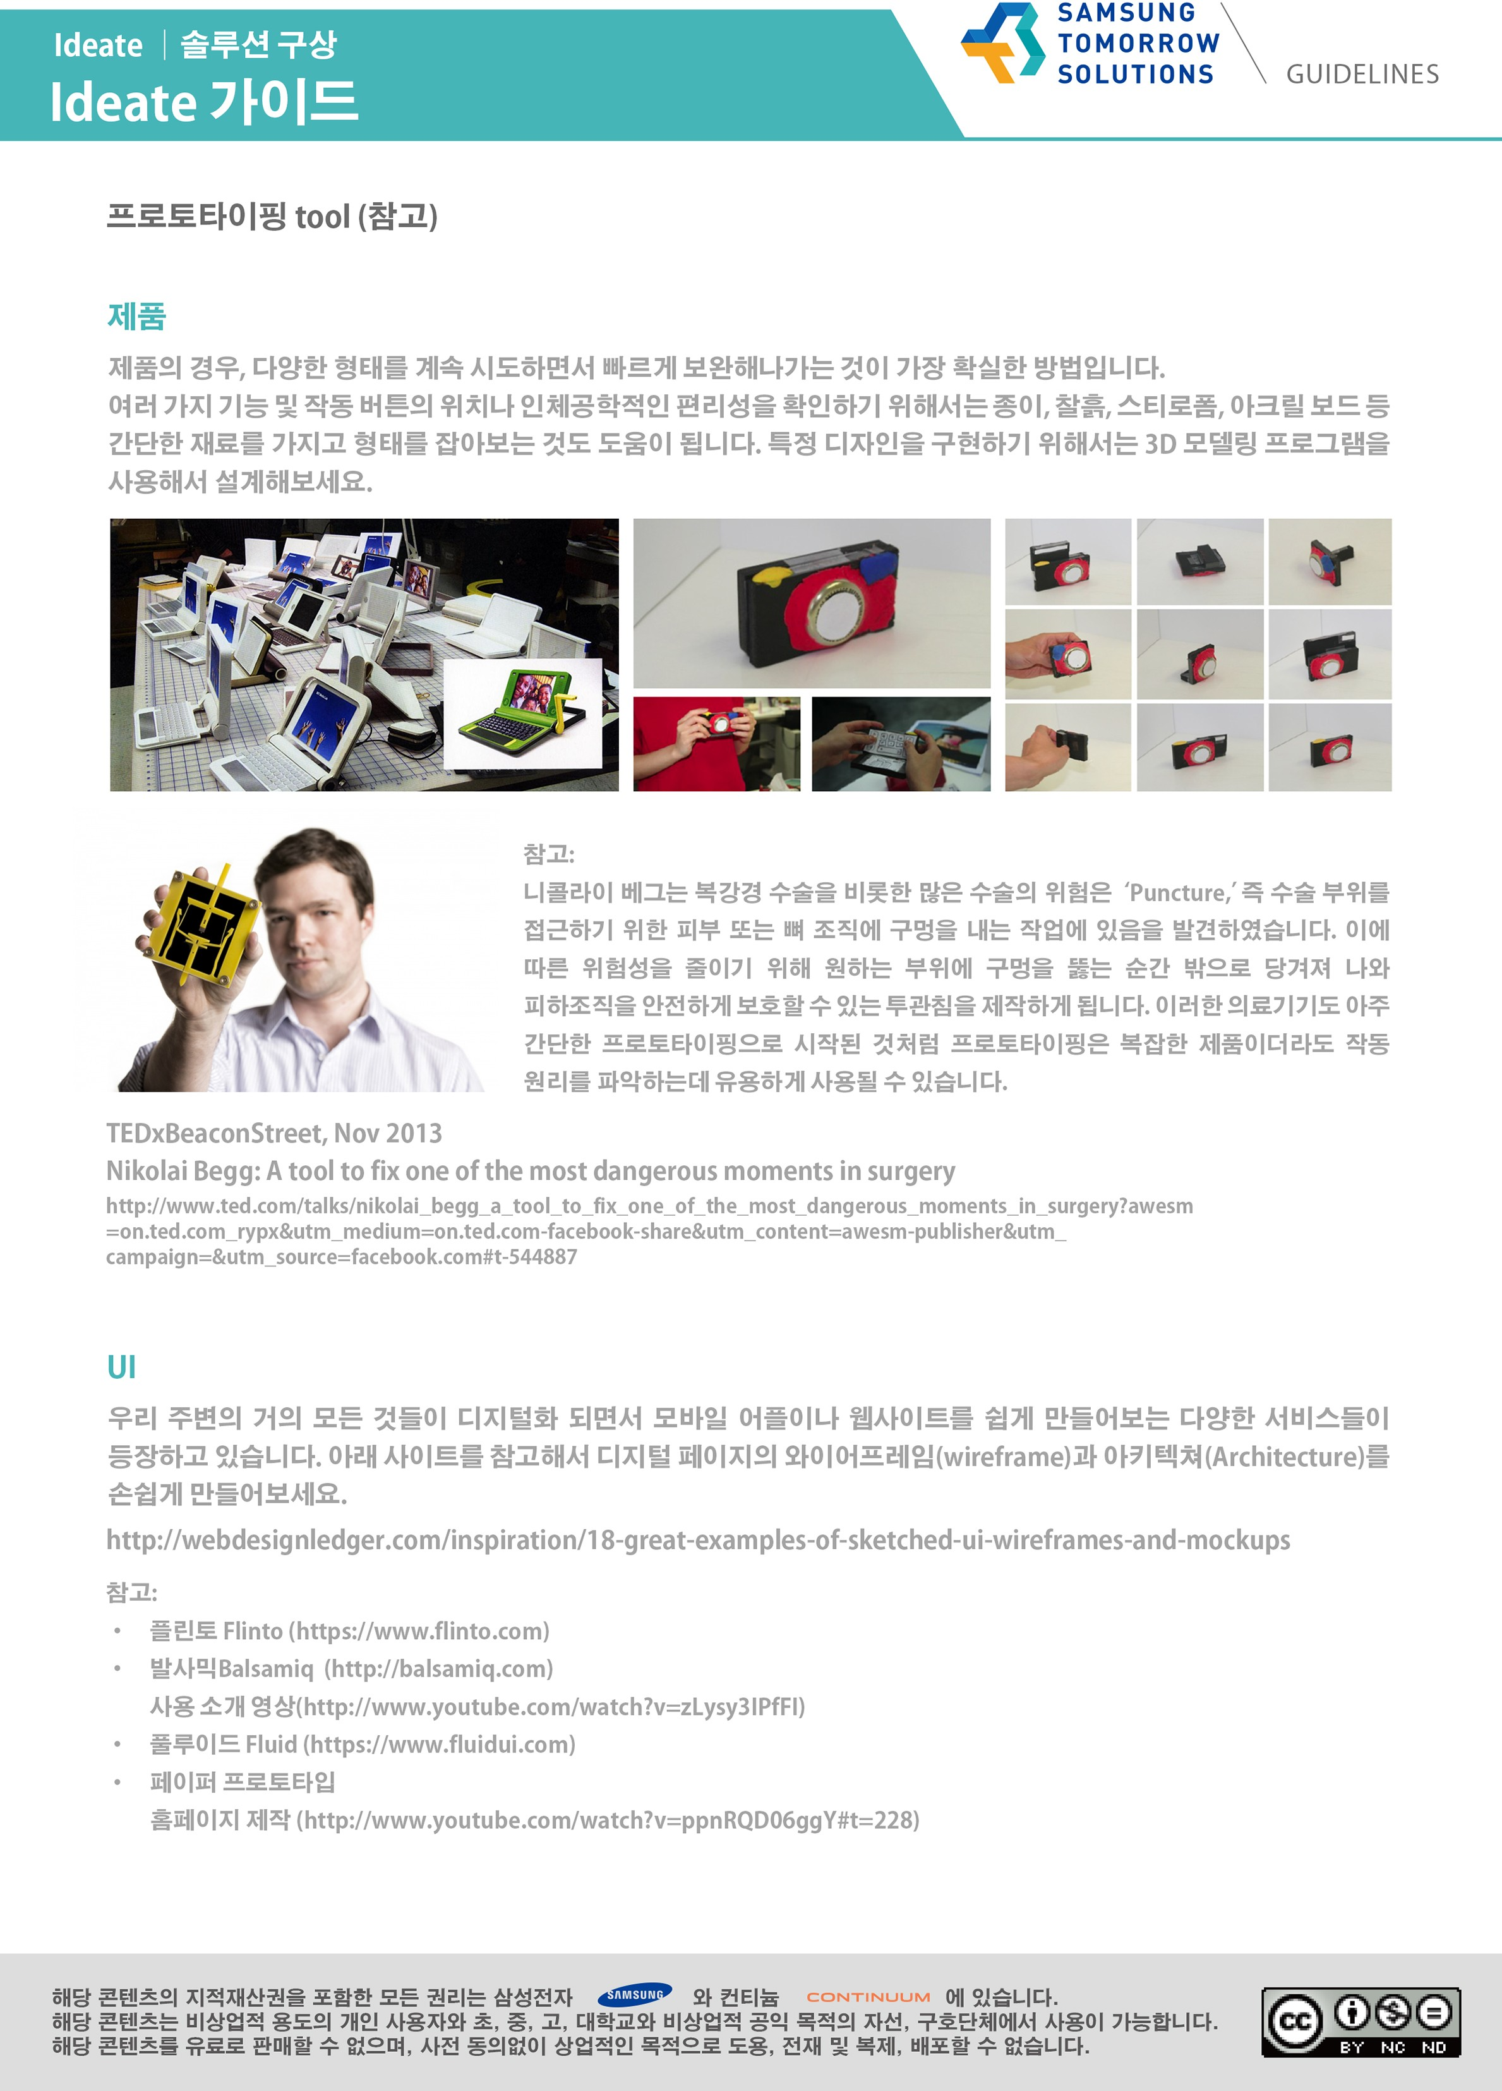
Unit 2. 2.2. Five Steps of Design Thinking
Ideate
Prototyping
Prototyping Tool : Products (for reference)
For products, it is the most certain way to try various forms and complement them quickly.
To check various functions, location of the operation button, and ergonomic convenience, it helps to make a form with simple materials such as paper, clay, Styrofoam, and acryl board. To implement certain design, try designing with 3D Modelling Program.
Notes:
Note:

Slide 74
Unit 2. 2.2. Five Steps of Design Thinking
Ideate
Prototyping
Prototyping Tool : UI (for reference)
As things are digitalized, various services that help making mobile applications and websites are coming out. Refer to the site below and try to make wireframe and architecture.
Reference
https://webdesignledger.com/18-great-examples-of-sketched-ui-wireframes-and-mockups/
Flinto (https://flinto.com)
Balsamiq (https://balsamiq.com)
Balsamiq Introduction Video (https://www.youtube.com/watch?v=zLysy3IPfFI)
Paper prototype Homepage making (https://www.youtube.com/watch?v=ppnRQD06ggY#t=228)
Notes:
Note:

Slide 75
Unit 2. 2.2. Five Steps of Design Thinking
Ideate
Prototyping
Prototyping Tool : Service (for reference)
Research resources are generally very useful for gathering the information you need, but it is difficult to show the full context or tell the story. Scenarios are a way to compensate for this and provide a realistic picture of the problem situation and create an expected situation to clearly communicate the effect when the solution is applied. In particular, the service solution is difficult to have a physical form or platform, such as a product or UI, so you can try how the service proceeds or interact with the beneficiaries through scenarios.
1. Design the whole story
Recall the series of moments your beneficiary experiences in a problem with the solution. The scenes should be organized in a structured way around the differences, including how existing problems are solved and what the beneficiaries will benefit from.
Notes:
Note:

Slide 76
Unit 2. 2.2. Five Steps of Design Thinking
Ideate
Prototyping
Prototyping Tool : Service (for reference)
2. Decide how to express
Think about how you can tell the story effectively. If necessary, it can be expressed in various ways such as concept board and shooting video.
3. Refine your solution
Think about what you need for each step to run the service. Think about what guides are needed for beneficiaries who use the services, and if there are no protocols for service providers to follow.
Notes:
Note:

Slide 77
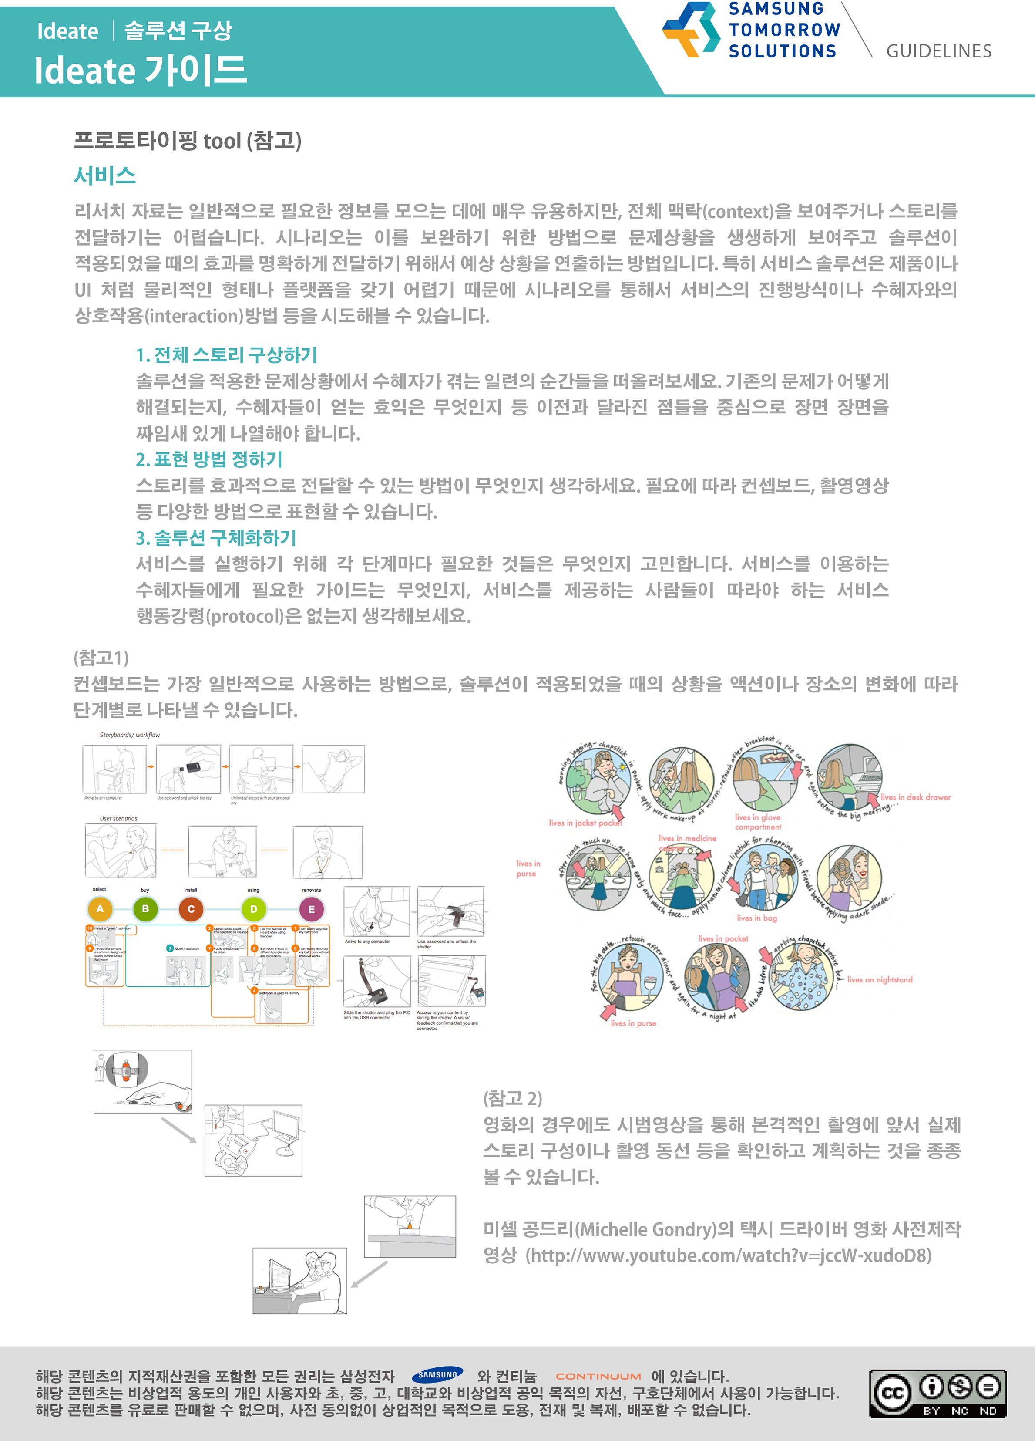
Unit 2. 2.2. Five Steps of Design Thinking
Ideate
Prototyping
Prototyping Tool : Service (for reference)
Concept boards are the most commonly used method, which allows you to represent what happens when a solution is applied, step by step, according to changes in action or location.
Notes:
Note:

Slide 78
Unit 2. 2.2. Five Steps of Design Thinking
Test
Step #5: Test
Define
Analyze
Test
Discover
Ideate & Prototype
Test the prototype in a realistic scenario.
Be critical. Avoid being defensive.
Find the deficiencies and improve!
Notes:
Note:
The key points are:
+Show the prototype to the user.
+Let the user experience your prototype. Then, observe him/her interact with the prototype.
+Gather the user feedback: focus on the “user experience”, “user feeling” and “user’s first impression”.

Slide 79
Unit 2. 2.2. Five Steps of Design Thinking
Test
Definition:
Definition and necessity of Test
It is easy to misunderstand the test as a gateway that determines success and failure.
However, test is a last stage of completing the solution. It inspects the prototyped solution in real situation of problem, and finds the room to improve and complement it.
If you apply the solution to the beneficiaries, you can check whether it is a necessary solution.

Slide 80
Unit 2. 2.2. Five Steps of Design Thinking
Test
Pre-Test: Test Preparation
1) WHERE : Find place and environment to apply the solution to.
Where is the place where the test is operated?
Did you get a permission from the facility manager?
2) WHO : Find the same beneficiary as the previously stated Persona. Solutions based on Persona, as itself, represent something. Effect of the solution gets more noticeable when the object of the test is a beneficiary in the situation. Find the beneficiary who can participate over the things that were written in Persona such as age, job, social group, social circumstances, essential item, etc. Even if it is the same Persona, you’d better test about 5 people not to lean toward one person’s opinion.
Who are the participants of the test? Are they participants based on Persona?
How many are they?

Slide 81
Unit 2. 2.2. Five Steps of Design Thinking
Test
Pre-Test: Test Preparation
3) WHAT : Establishes evaluation criteria that consider both functional and emotional aspects. To assess the effectiveness of your solution, see whether it solves the problem functionally or satisfies the emotions you need.
Is it an evaluation standard that considers both functional and emotional aspects?
Did the criteria reflect what you wanted to solve with our solution?
Can the metrics measure the impact before and after the solution?
Functions | Emotions
How convenient is it? How efficient is it? Is it a system that anyone can learn easily? Is it designed for the beneficiary's behavior? Is it causing another problem? (Efficiency and convenience) | What is the beneficiary's satisfaction with problem solving? Does it match the lifestyle of the beneficiary? What impact does this change have on the beneficiary's life? Does it cause another problem? (Emotional stability)

Slide 82
Unit 2. 2.2. Five Steps of Design Thinking
Test
Pre-Test: Test Preparation
4) HOW : Plan effective test methods. Think about how to test your solution. Make practical plans such as the schedule, audience, and location, as well as how you will observe the beneficiary, what will be interviewed, and how many people will be present.
Are the schedule, destination, location, etc. confirmed?
Are the roles between the team members interviewed clearly defined?
What would we like to test?

Slide 83
Unit 2. 2.2. Five Steps of Design Thinking
Test
Test: Test Execution
1) EMPATHY : Be a beneficiary.
IS WHAT : Thinking about the persona profile you created earlier, this is a way to experience the problem situation where the solution is applied directly like a beneficiary.
DO WHAT : Predict what behavior your beneficiaries will see when experiencing a new system they are not familiar with, and see if they can easily accept the solution and see if there are any problems.
TIP : It's a good idea to run this method as a means of checking the solution one more time before starting a full-scale test on beneficiaries.

Slide 84
Unit 2. 2.2. Five Steps of Design Thinking
Test
Test: Test Execution
2) OBSERVATION : Observe the beneficiary.
IS WHAT : Applying the solution to the actual situation and observing the beneficiary's response under the same conditions as usual..
DO WHAT : Write down what you want to see and observe the site in advance, as expected, whether the solution works and what happens to the beneficiary's behavior. Evaluate each item to see what and how to improve it.
TIP : Observe the solution's effectiveness by observing the beneficiary's most natural behavior, in the same way as the observation that you did during the Discover phase.

Slide 85
Unit 2. 2.2. Five Steps of Design Thinking
Test
Test: Test Execution
3) INTERVIEW : Ask the beneficiary.
IS WHAT : Interview with the beneficiary what they need to know about the solution. Most commonly, the beneficiary first experiences the environment in which the solution is applied, and then asks questions about it..
DO WHAT : The interview asks the beneficiaries for their opinions and advice on what they like, what is uncomfortable or unnecessary, and what needs to be compensated for.
TIP Depending on the type of solution, the beneficiary may be able to ask questions as well as experience, and may be interviewed after a week of testing.
← When conducting an interview after the test period, you must pre-select the test period and provide a mission or assignment that the beneficiary must complete to determine what they want to know during the test period.

Slide 86
Unit 2. 2.2. Five Steps of Design Thinking
Test
Post-Test: Test Results Summary
1) REACTION & RESULT Measure the beneficiary's response and the effectiveness of the solution.
See how the beneficiary responds, how the solution actually solves the problem, how satisfied are the beneficiaries of the solution, and whether there are any emerging problems or unexpected effects in applying the solution.
2) NEXT STEP : Find the missing parts of the solution and find ways to fix it.
Apply the solution in real life, and think about how you can modify and supplement it. Find out what you need to do to increase the effectiveness of your problem solving and plan a specific action plan. And validate…
Business plan that describes how to commercialize our solution in the future
Selected technology partners and experts who think what our solution needs
How much money will you need and how will you get support?
Know when it's feasible and what's the specific action plan for the future

Slide 87

End of
Document
Samsung Innovation Campus

